Slide 1

Exploring Music Genre Association

Slide 2
Introduction
Objective:
Find the relationship between Musical features and popularity on Spotify and YouTube.
Dataset:
Spotify and YouTube dataset about songs singed by different artist in the world

Slide 3
Introduction
Analysis: Conducted regression analysis and K-mean clustering to identify patterns in the data.
Insight: Provide insights into music consumption and preferences in the digital age through analysis of the Spotify and YouTube dataset.

Slide 4
Data Product
Classification Model: Predicts song genres based on musical features.
Regression Model: Analyzes the relationship between musical features and views.
Recommendation System: Uses Association Rule Mining to generate personalized song recommendations.

Slide 5
Data Product
Benefits:
Offers valuable insights for artists and labels to inform marketing plan
provides users with a better music discovery experience
Insights: Predicts successful song genres and identifies factors that make to success on streaming platforms

Slide 6
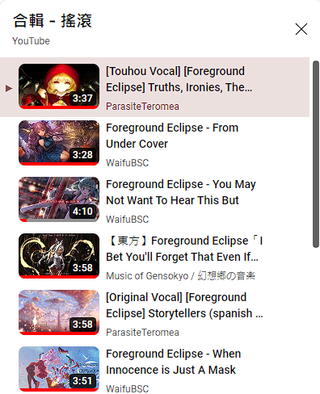
Data Product
Personalization:
Provides personalized recommendations to users based on their listening preferences
Like what now YouTube doing

Slide 7
Data Preprocessing
Data cleaning, imputation, and feature selection:
Checked for missing values and dropped rows with missing value
Selected relevant variables for analysis and dropped unuseful variables.
Normalization of numerical variables
Converted categorical variables to numerical format.
Standardized numerical variables to ensure all variables are on the same scale.

Slide 8
t-sne visualization
Dimension reduction:
Used t-SNE to reduce dimensionality of the data to 2D
Benefits:
Reduces redundancy in high-dimensional data
improves visualization
reduces training times

Slide 9
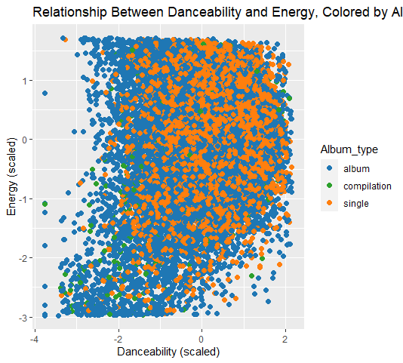
t-sne visualization
Visualization:
Created scatterplot before t-SNE to visualize relationship between "Danceability" and "Energy" variables.
Scatterplot showed
variables were somewhat uncorrelated
each may be important in predicting target variable.

Slide 10
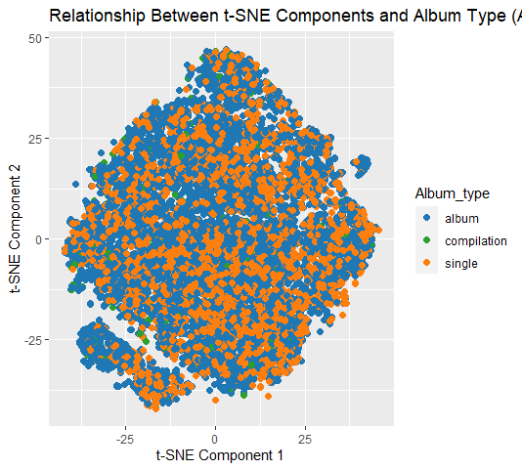
t-sne visualization
Created scatterplot after t-SNE to visualize relationship between t-SNE components 1 and 2.
Scatterplot showed data points were more grouped along t-SNE component 2 axis

Slide 11
Regression Analysis
Investigated relationship between Musical features, views, and stream.
Divided data into training and testing sets and fitted regression models to training data.
Converted variables to numeric data types and used models to make predictions on testing data.
Evaluated model performance using R-squared values.

Slide 12
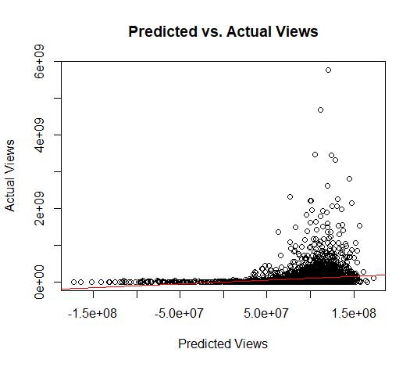
Views Model
Fitted linear regression model with Spotify streams and YouTube views as dependent variables and Musical features as independent variables.
Scatter Plot: Shows model is reasonably accurate with most points falling within tight band near diagonal line.

Slide 13
Views Model
Outliers: Some outliers where model's prediction is far off from actual value may be worth investigating.
R-Squared Value:
R-squared value for Views: 0.01862232
Low R-squared value suggests included independent variables are not very effective at predicting number of views of the song will receive based on audio features

Slide 14
An example using the views model
There has been a user who uploaded a new music on YouTube.
We have data about features of music.
In this example we set feature of music is,
Danceability = 0.8, Energy = 0.1, Key = 7, Loudness = 5.2, Speechiness = 0.01, Acousticness = 0.05, Instrumentalness = 0.1, Liveness = 0.1, Valence = 0.6, Tempo = 60

Slide 15
An example using the views model
By the coefficients of the model, I can predict how many views will this song have. By using predict function in R. We get.
Predicted number of views for the new song: 174197684

Slide 16
Model on stream
Fitted linear regression model with stream as dependent variable and Musical features as independent variables.
Coefficients: Suggest most variables have very small or near-zero values,

Slide 17
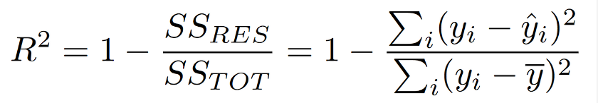
Model on stream
Listener on Spotify may not choose music based on Musical features.
R-Squared Value: Cannot be calculated due to close values of total sum of squares and residual sum of squares

Slide 18
Clustering Analysis
Grouped similar songs together based on their musical features using k-means clustering.
Scatterplot: Created scatterplot of t-SNE result to visualize data distribution before clustering.

Slide 19
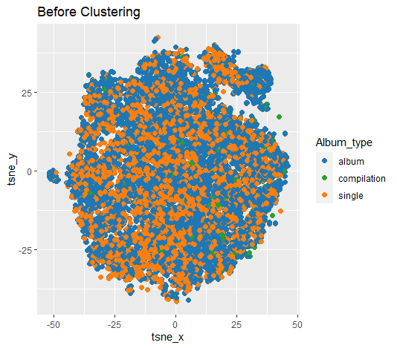
Before K-mean clustering
Performed k-means clustering with
k = 4
2 iterations
different starting centroids

Slide 20
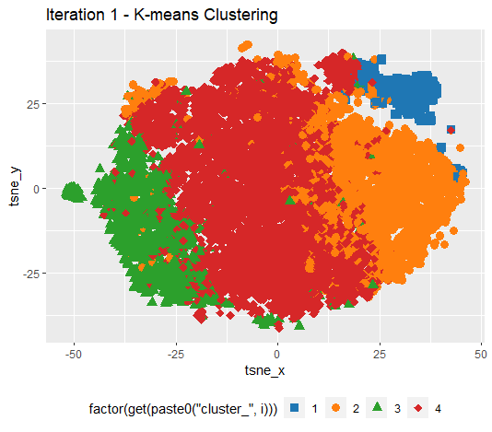
Iteration 1
Scatterplot showed four well-separated and distinct clusters, indicating successful grouping of songs with similar musical features

Slide 21

Iteration 2:
Scatterplot showed almost identical clusters to Iteration 1
suggesting cluster solution is stable and consistent.

Slide 22
Clustering Analysis
Musical Features: Analysis of each cluster's musical features provided insights into overall characteristics of songs in each group.
Cluster 1: High levels of energy, loudness, and valence, suggesting upbeat and energetic songs.
Cluster 2: Low levels of energy and acousticness, indicating mellow and acoustic songs.

Slide 23
Clustering Analysis
Cluster 3: High levels of instrumentalness and low levels of speechiness.
Cluster 4: High levels of danceability and speechiness.
Our clustering analysis provided insights into how different musical features contribute to the overall characteristics of each group of songs.

Slide 24
Association Rule Mining
Used apriori algorithm with support threshold of 0.0002 and confidence threshold of 0.3
Low Support: Acceptable due to big dataset.
Association rule mining provides insights into relationships between items in the dataset
Can inform decision-making in various domains, such as marketing

Slide 25
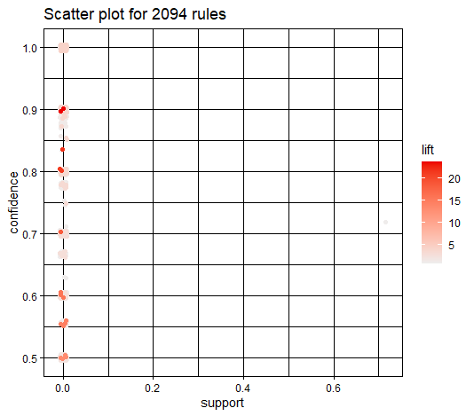
Association Rule Mining
Scatterplot: Generated scatterplot to show relationship between support and confidence for each rule.

Slide 26
Recommendation System
Strong associations between the items in the dataset and could be useful for applications such as recommendation systems.
Built filtering recommendation model based on user ratings
Aimed to generate recommendations for test set and use the model to real situation

Slide 27
Recommendation System
Converted data to sparse matrix format and split into training and testing sets.
Used collaborative filtering to build recommendation model and generated top 5 recommendations for each user in test set.

Slide 28
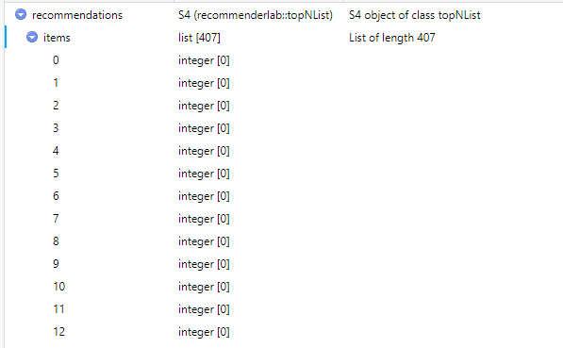
Recommendation System
However, recommendation system failed to generate any recommendations for test set
Possible Reasons:
there was not enough data or user-item interactions in the test set

Slide 29
Future Steps
Relationships between other attributes
such as lyrics or release dates
Explore other data mining techniques to determine which approach is most effective for analyzing music data

Slide 30
Conclusion
Analyzed dataset of musical features and views, and other variables for sample of songs using regression analysis, clustering, association rule mining, and recommendation system building.
Findings provided insights into music consumption and preferences in digital age.

Slide 31

Q & A session

